Slide 1


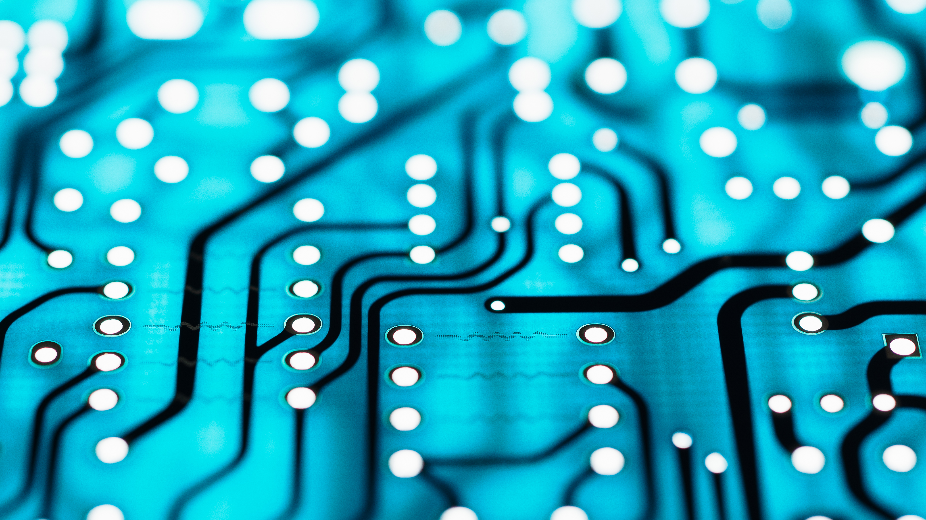
WiTricity wireless power transfer
Syed Ali

Slide 2
What is WiTricity
WiTricity is abbreviated as “ wireless electricity ”.
Transfer of electricity without using connections between input and load is termed as wireless electricity.
This is not like wireless transmission of signals which we used in the cell phones.
In cell phones signals are sent in the form of micro waves whereas in this mode of transition electricity is transferred in the form of magnetic rays.
These rays are not harmful to humans
The transfer of energy is mid range compared to direct transmission

Slide 3
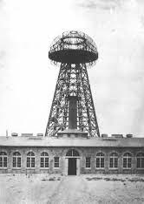
Introduction
In late 1890, Sir Nicola Tesla proposed a method of wireless power transmission. But it was in most radiative mode, so most of the power is wasted during transmission.
In 1899, Tesla achieved a breakthrough in his work in Colorado by transmitting 100 million volts of electric power wirelessly over 26 miles to light up a bank of 200 light bulbs and run one electric motor.

Slide 4
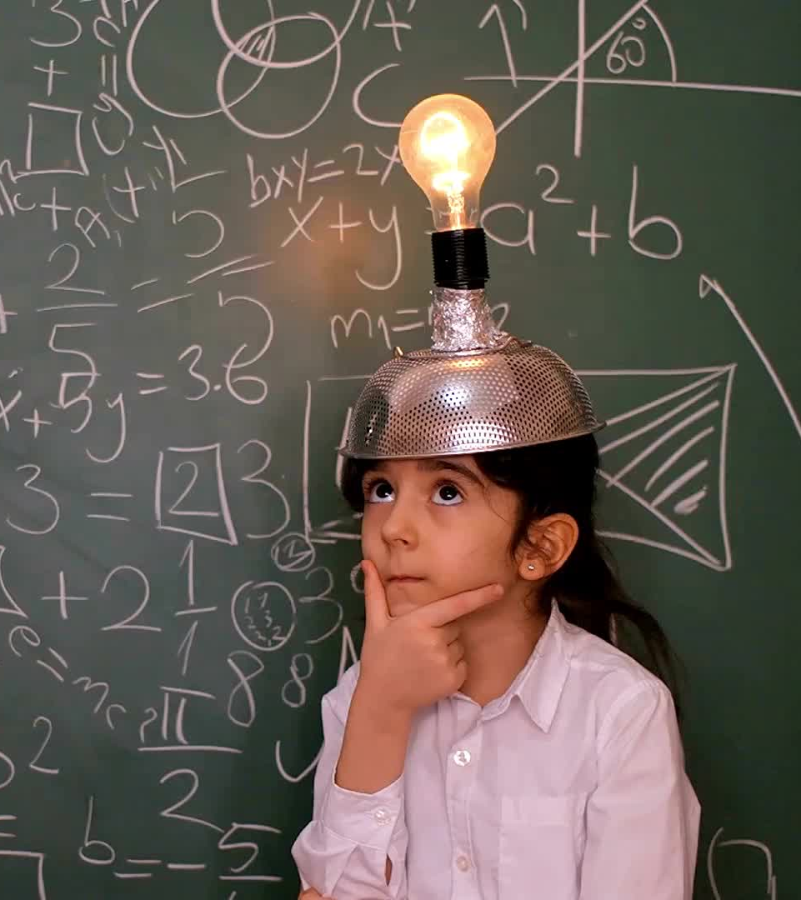
In 2005, Dave Gerding first time use the term WiTricity which is being used today.
A group of six MIT students managed to turn on a 60-watt bulb in 2007 which was led by Mr. Marin Soljacic.
The story started late one night the few years ago. It was probably sixth time of that month. Mr. Marin was awakened by his cell phone beeping low battery warning signal.
At that time, he thought about the transmission of electricity without wires. This is a most important cause for WiTricity.

Slide 5
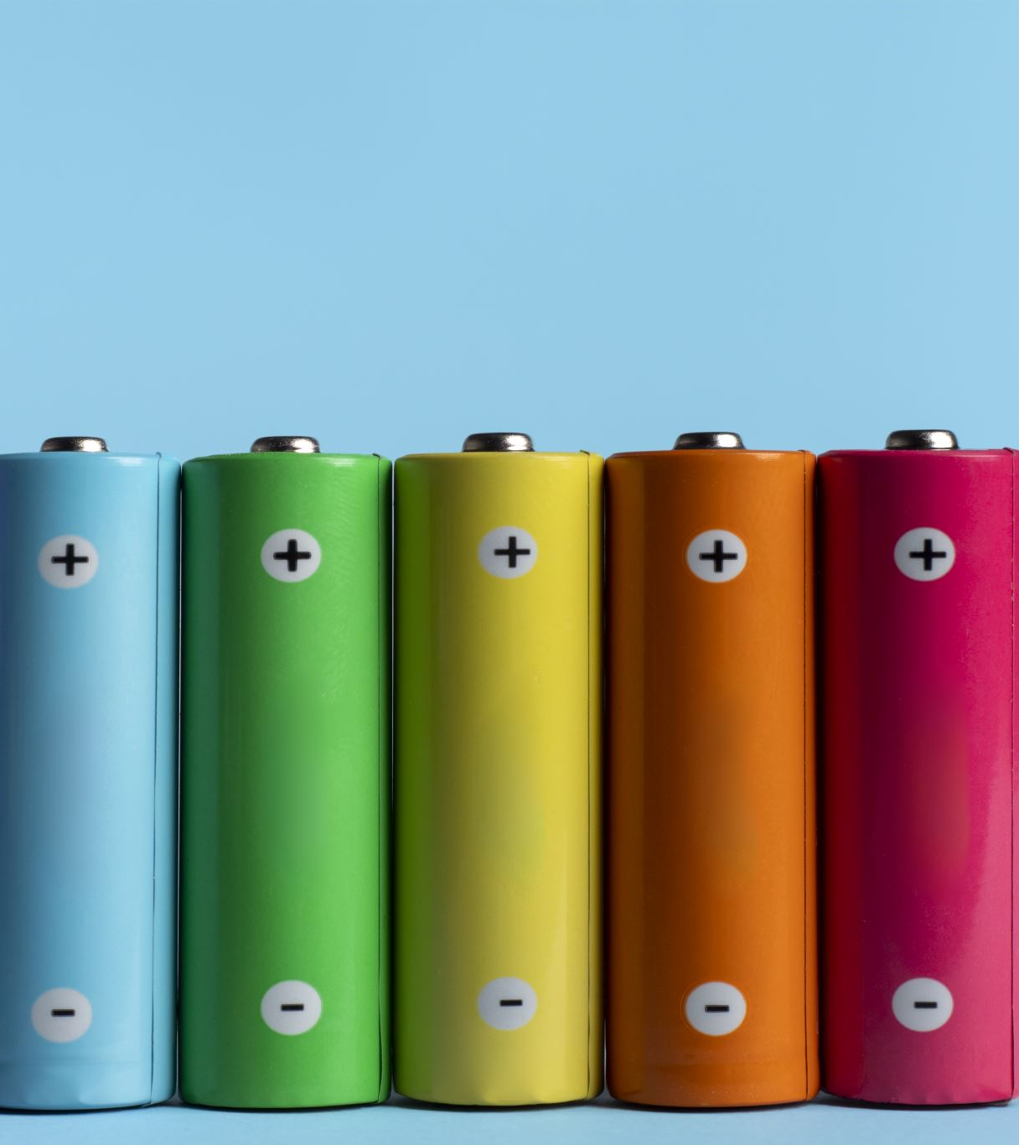
Need of WiTricity
Now-a-days there is a rapid increase of electronic goods like cell phones ,laptops ,I-pods etc., which rely on the chemical storage of energy by the battery which need to be recharged frequently As these are becoming daily needs to the present generation wireless energy transfer i.e., WiTricity would be useful for many applications as these things need mid range energy.

Slide 6
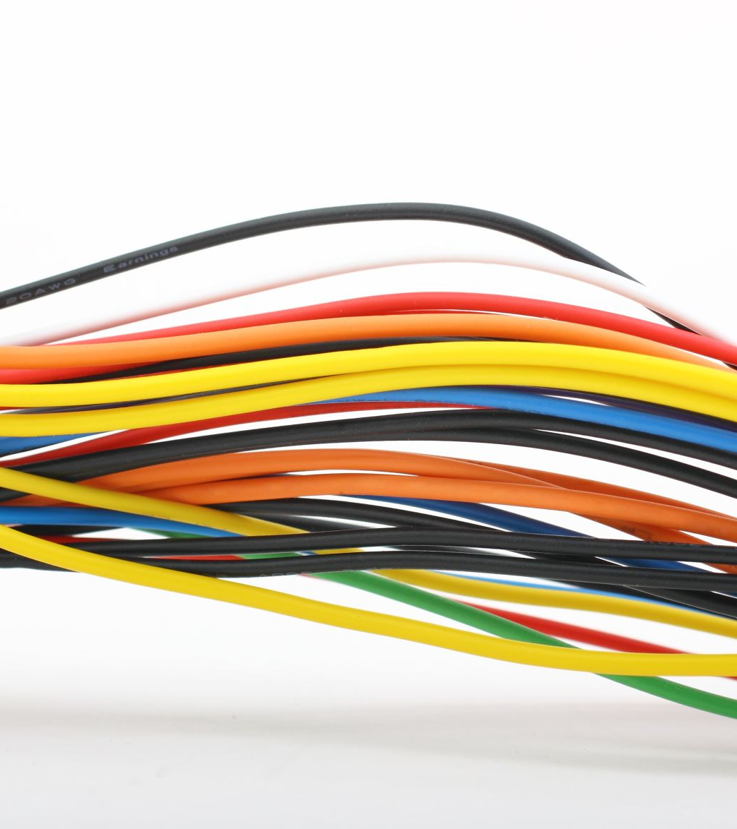
Limitation
A Tesla Coil produces high voltage electric arcs. These arcs cause permanent damage to electrical devices on contact
It is not capable of working in Direct Current, It works only in Alternating Current.
The resonance condition should be satisfied and if any error exists, there is no possibility of power transfer.
If there occurs, a very strong ferromagnetic material presence, then there may be a possibility of low power transfer due to radiation.

Slide 7
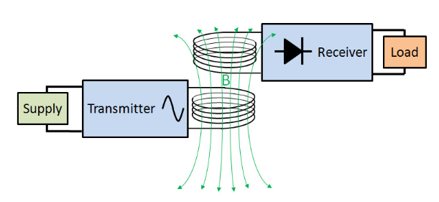
Working principle of WiTricity
WiTricity works on the principle of mutual induction between the two copper coils.
There are two copper coils arranged one at the sender side and other at the receiver end .The first coil is attached to the power source while these second coil to the light bulb or any load.
When the power is switched on the first coil converts the electricity into magnetic field, which is oscillating at a particular frequency i.e., AC source.
The second coil at the receiver end converts the magnetic field into electricity .The surrounding environment is unaffected.

Slide 8

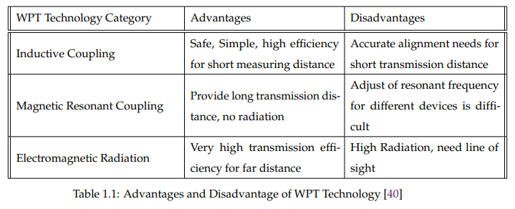
Types of WiTricity
There are three types of WiTricity
Short range Inductive Coupling
Medium range Magnetic Resonant Coupling
Long range Electromagnetic Radiation

Slide 9
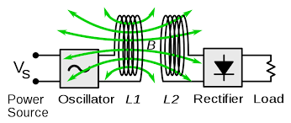
Inductive coupling
Inductive coupling works on the principles of electromagnetism.
When a current (electricity) passes through a wire, it generates a magnetic field perpendicular to the wire.
When a wire close to a magnetic field, it generates a current in that wire.
Magnetic fields decay quickly, making inductive coupling effective only at very short ranges.

Slide 10
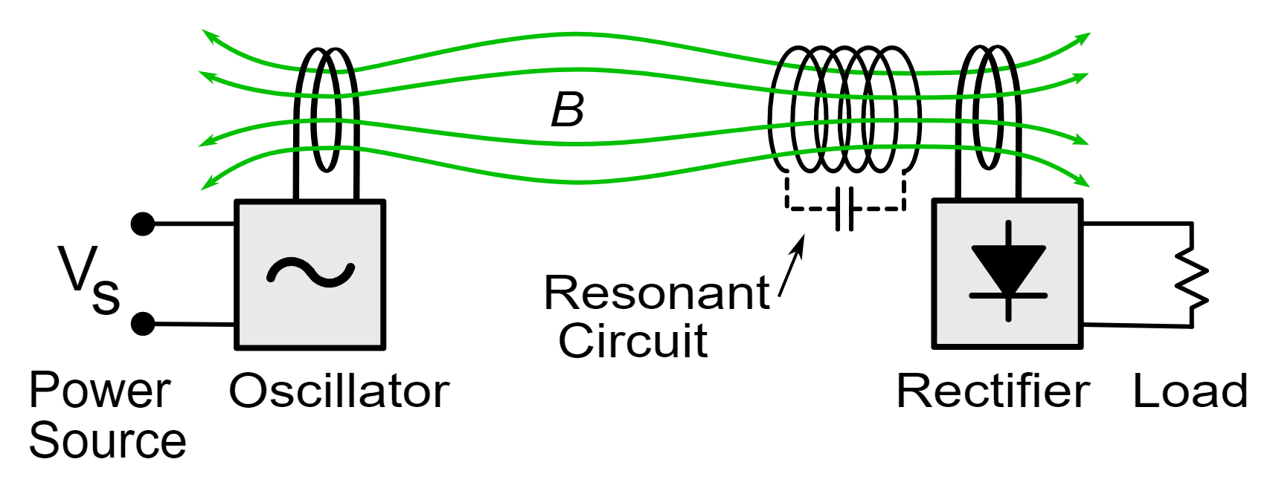
Resonant Magnetic Coupling
Resonant induction still uses the same principles as magnetic induction(magnetic fields to transfer current)but it uses resonance to increase the range at which the transfer can efficiently take place.
"Resonance", a phenomenon that causes an object to vibrate when energy of a certain frequency is applied.
Everything resonates at a certain frequency, based on its shape and material.
Energy transfers easily between resonating objects. An example of this is when an opera singer shatters wine glasses by singing at the frequency at which the glasses resonate.
With resonant induction, power is transmitted between two resonating coils.

Slide 11
Electromagnetic radiation
In long range the electricity is converted into microwaves and transmitted for a long distance.
High transmission efficiency for far distance.
It is on going research in the field of WiTricity.

Slide 12
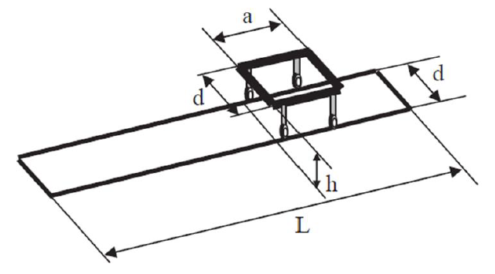
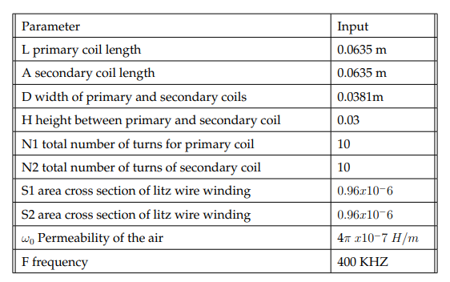
Coil Designing
There are two main design configuration for Wireless power transfer circular and rectangular. In my project rectangular coil has been used which offer good coupling results without any misalignment consideration. The transmitter coil is place under the table and the receiver coil should be place under the buss so that when the buss come under the range of primary coil it start charging the buss battery

Slide 13
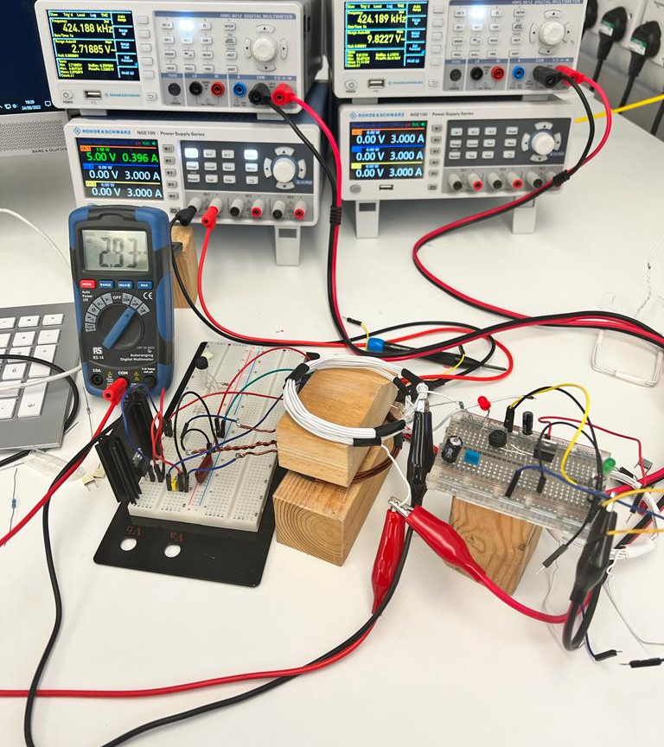
Experimental Results

Slide 14
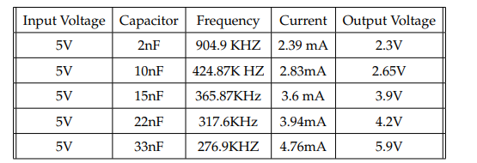
Observational result for circular coil
In this experiment two coil are used. Primary coil consist of 6 turns and Secondary coil consist of 16 turns with the air gap of around of 0.03 meters, respectively. As with the help of experimental value we can say that when the frequency of the increase the voltage on the secondary side across the led decrease. Furthermore, we can also analyze the capacitance of the circuit in inversely proportional to the frequency means if we increase the capacitance value frequency will decrease and vice versa.

Slide 15
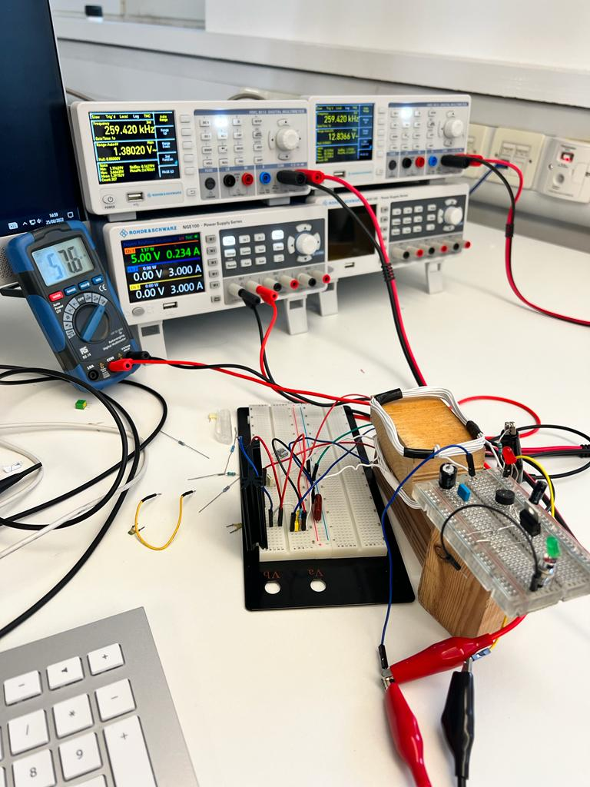
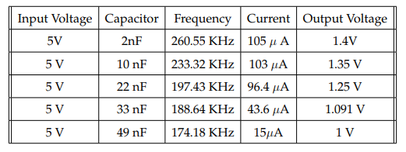
Observational result for rectangular coil
For this experiment primary coil consist of 10 turns and the secondary coil circuit have 10 turns as well. The air gap between two coil is around 0.03 meters. The shape of the coil is different from previous reading now coil shape is rectangular which provide better result with less number of turns as compare to previous reading.

Slide 16
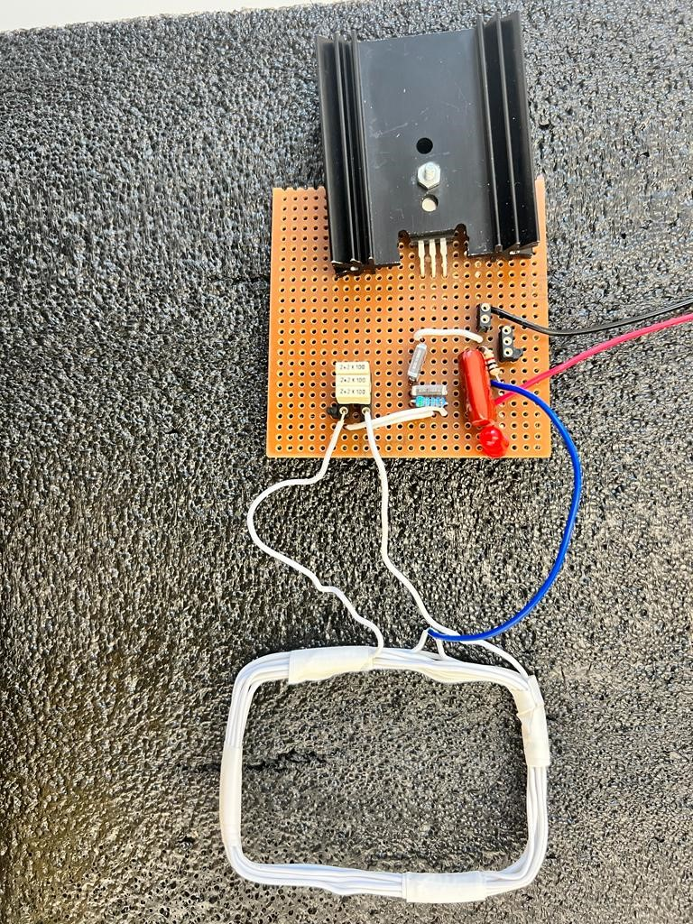
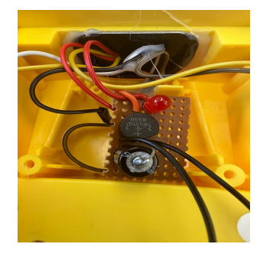
Circuit Designing
Transmitter circuit
Receiver circuit

Slide 17
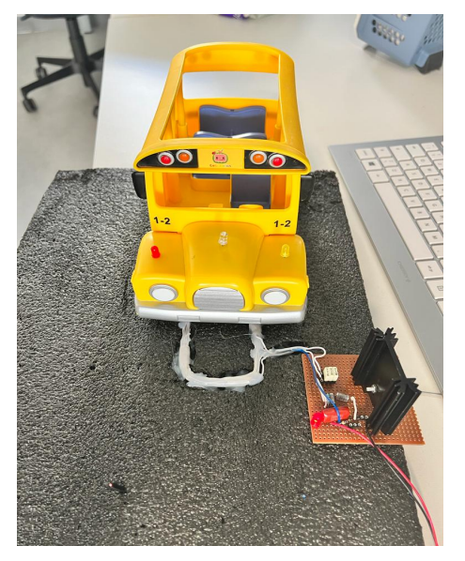
Implementation of Prototype
In this project, I work on wireless power transfer based on electric vehicle due to that reason I have design a toy buss or car charging system in which two coils are used transmitter and receiver coil. The primary coil should be aligned with the ground level and the secondary coil is fitted inside the buss so that when buss come under the primary coil then led glow but when their is a misalignment between transmitter and receiver coil the led will not glow.
In 2009 a 60 KW online electric vehicle (OLEV) develop by KAIST for electric buss having 72% efficiency and coil to coil gap of 10 mm.
Later this year Utah state university develop 50 KW electric buss charging system with 90% efficiency and operational frequency of 20kHZ having air gap of 15 to 30cm

Slide 18
Power Losses
The majority of inductive coupling-based high-power wireless charging solutions contain system efficiencies between 80 and 90%
Joule Heating: It is a phenomena that happens whenever a wire or component has current flowing through it.
Skin Effect: When conductors are subjected to an alternating current. The "skin" of the conductor experiences current flow as a result of this phenomena. The skin depth decreases with increasing frequency, increasing resistance. As a result, the cable will heat up and experience additional joule losses.
Switching Losses: The switching loss is generated by MOSFET which required a particular time to switch the circuit on and off which create loss in power transfer. Due to very fast switching produce heat in the circuit which cost high internal impedance or sometime may increase the temperature of the circuit.
Proximity Effect: A phenomenon known as the proximity effect happens when two conductors through which an AC current runs are close to one another. Eddy currents will form as a result, altering the current density

Slide 19
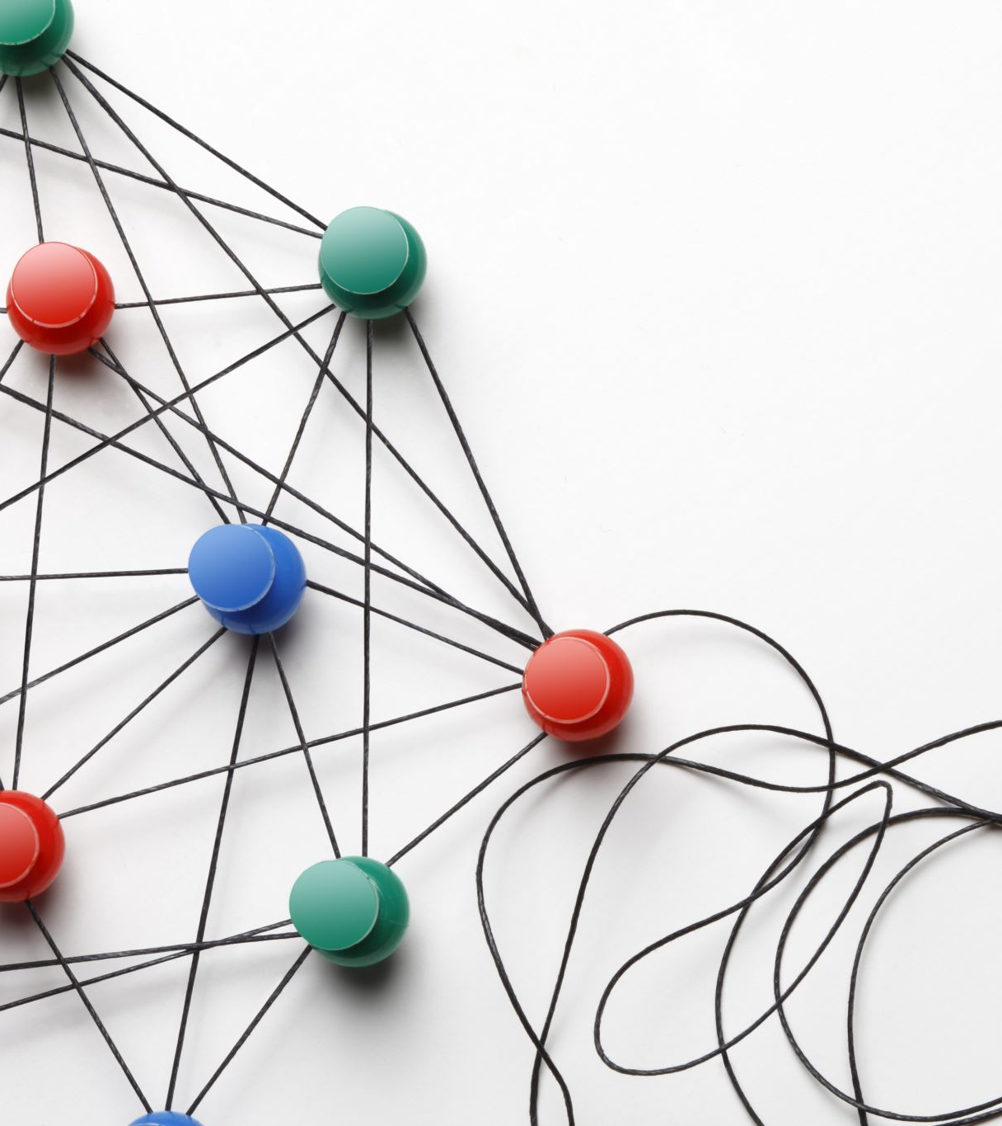
Is WiTricity Safe?
Many people are concerned about other radio fields or frequencies flying through the air. Some believe that these are harmful to the body but there is little evidence to suggest they are.
WiTricity, however, turns electricity into a magnetic field, which is a non-radiative transfer method. Magnetism interacts very minimally with biological organisms and is not harmful at all to humans or animals.
WiTricity has been scientifically proven not to be harmful and has been designed to comply with applicable safety standards and regulations.

Slide 20
Advantages
WiTricity is consider as Safe, fairly efficient, good range.
Magnetic fields interact weakly with biological masses(humans), Theoretically one stationary coil in a room could power multiple devices with receiving coils. No more messy wires, and with widespread enough use it could even eliminate costly batteries.
No manual recharging and changing batteries which reduces the usage of disposable batteries.

Slide 21
Application
Automobile Car
Manufacturing Industry
Military Equipment
Medical Instrument
Commercial electronic product

